Slide 1
AUTOMATED GUIDED VEHICLE HARDWARE SYSTEM
Name: Luqman Hakim Bin Mohamad Salmi
Matric Number: 1718219
Section: 1

Slide 2
Main Components
Physical design for various applications
Locomotion system and actuators
Navigation system and control
Data collection
Data transmission
Power management

Slide 3
Physical Design
There are three types of AGV system which are:
Unit load carrier
Driverless train
Pallet truck

Slide 4
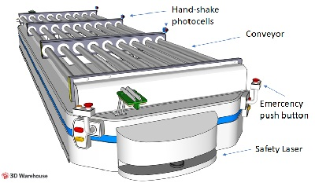
Physical Design
Physical design of a unit load carrier AGV system
Used for transporting items from one place to another by carrying the load on top of the AGV with the help of the conveyor
Mainly used to carry small loads

Slide 5
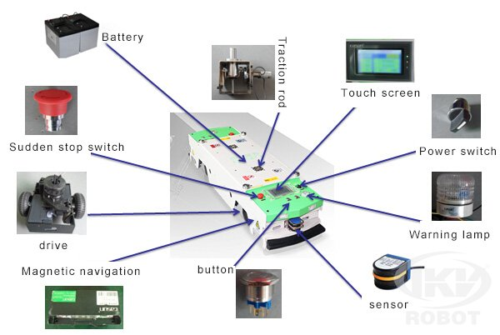
Physical Design
Physical design of a driverless train AGV system
The design is almost similar to unit load carrier AGV system but without the conveyor
Transports loads by pulling several trailer carts attached at its back

Slide 6
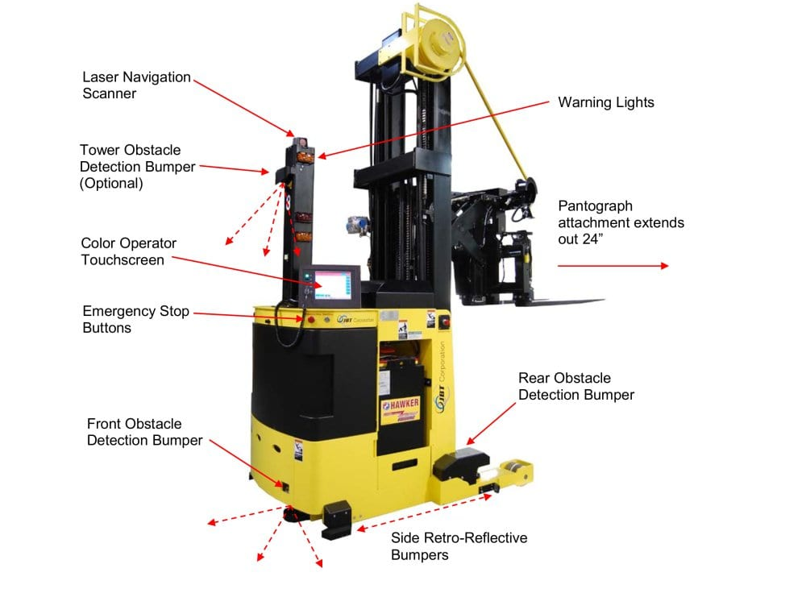
Physical Design
Physical design of pallet truck AGV system
Works like a normal forklift but unmanned
Mainly used to transport heavy loads from one point to another

Slide 7
Locomotion System and Actuators
Types of wheels used in AGV system
Standard wheel
Caster wheel
Mecanum wheel

Slide 8
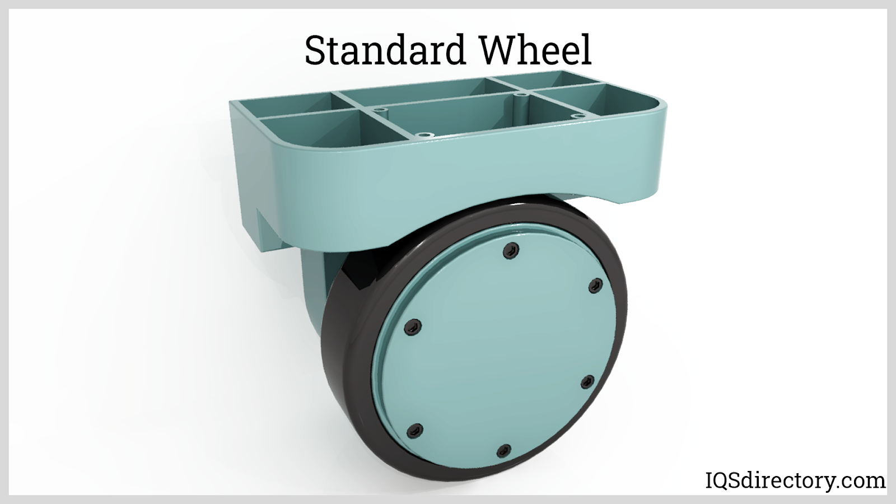
Locomotion System
This standard wheel have two degrees of freedom, one around the wheel axle and one around the contact point
This wheel design allows the AGV to steer without imparting additional forces to the robot chassis as its axis of rotation passes through the center of the wheel

Slide 9
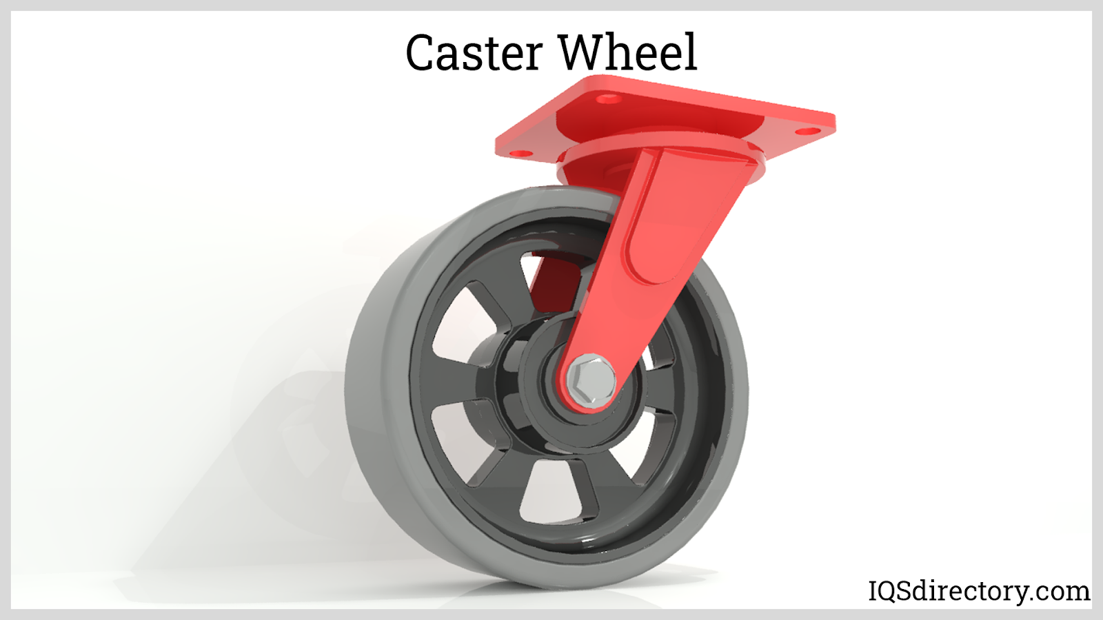
Locomotion System
This wheel design is almost similar to the standard wheel design but there is a slight offset between the axis of rotation around the contact point and the center of the wheel
Rarely used for maneuvering
Have the advantage of automatic alignment when moving forward after turning

Slide 10
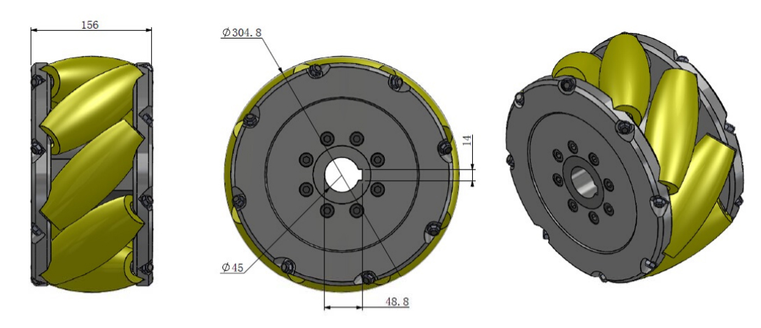
Locomotion System
Mecanum wheel
Widely used in AGV systems due to it being omnidirectional
Have three degrees of freedom, one around the wheel axis, one around the rollers and one around the contact point
The rollers in mecanum wheels are arranged in 45° angle around the circumference of the main wheel

Slide 11
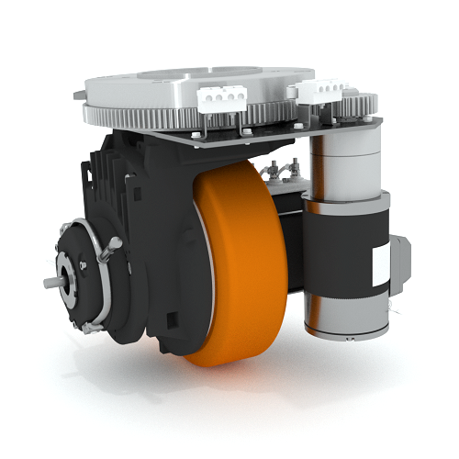
Actuators
This actuator is used in the standard wheel design
Have two motors build into the wheels to control the two axis of rotations that exist in this type of wheel

Slide 12
Navigation System and Control
Types of navigation of AGV system
Magnetic tape
Optical vision
Laser
SLAM (Simultaneous Localization And Mapping)

Slide 13
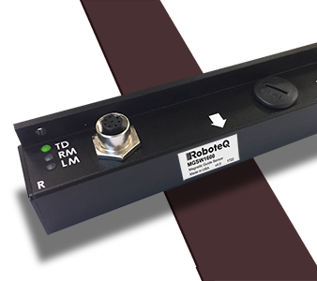
Navigation System and Control
Magnetic tape
The AGV system are equipped with a magnetic reader at the lower front
The magnetic reader is used to navigate the AGV by detecting the fluctuations in the magnetic field created by the tape installed on the ground of the facility
Similar to a line following robot

Slide 14
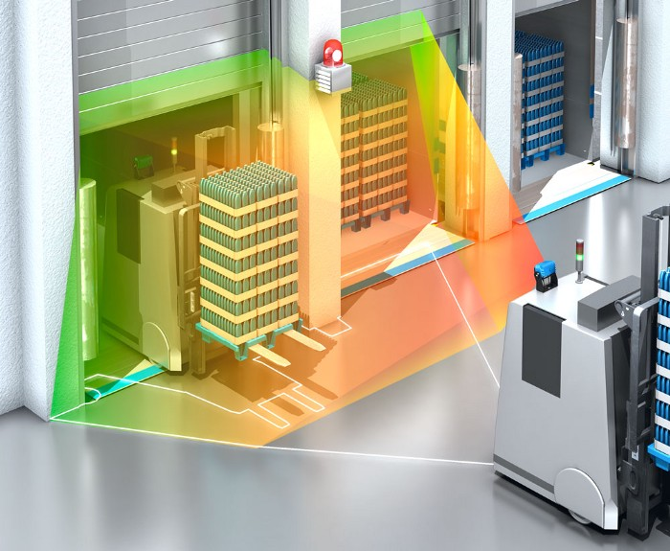
Navigation System and Control
Optical Vision
Navigates through the environment with the help of cameras or sensors
Able to identify obstacles along its way and avoid it automatically
The cameras can also be used for surveillance purposes

Slide 15
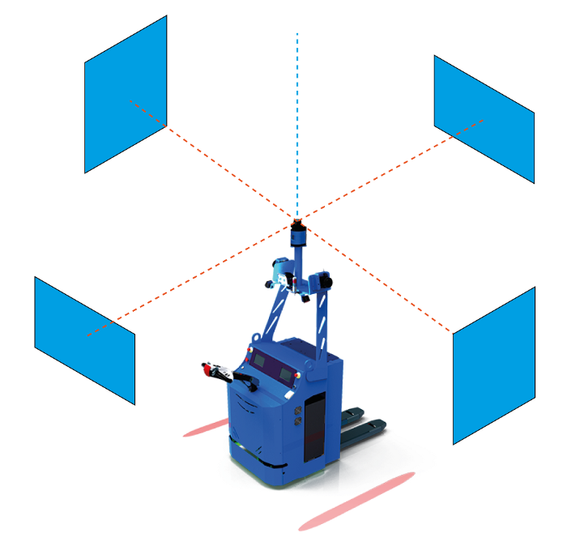
Navigation System and Control
Laser
The AGV is equipped with a device that emits thousands of light beams per second
The light beams bounces onto small reflectors on the walls and the time taken for the beam to come back is calculated to know the actual distance between the AGV and the walls
By detecting 3 or more different reflectors, the vehicle position can be calculated by triangulation and can be compared to the map of the facility already stored in memory

Slide 16
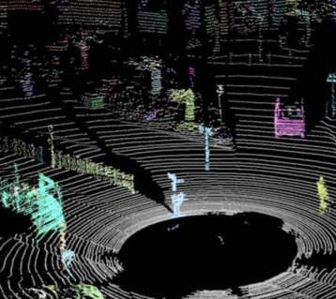
Navigation System and Control
SLAM (Simultaneous Localization And Mapping)
Navigates through the facility using LIDAR (LIght Detection And Ranging)
The SLAM navigation system does not only navigate through the facility but also maps it in real time with its sensors

Slide 17
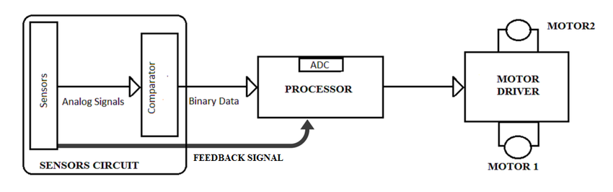
Data Collection
Block diagram of line following navigation system in AGV
It receives data from its sensors, processes it and operates the motors based on the processed data
The data is processed within the AGV system itself

Slide 18
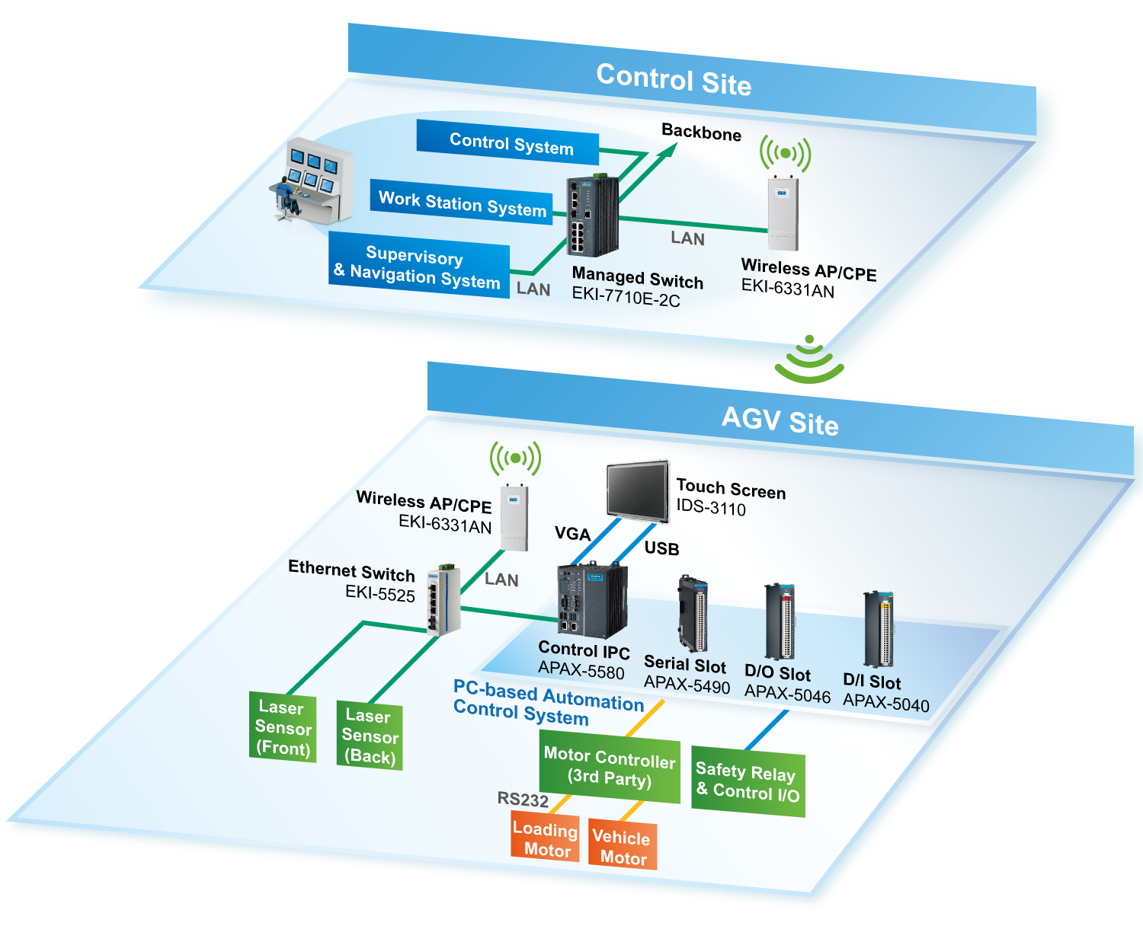
Data Transmission

Slide 19
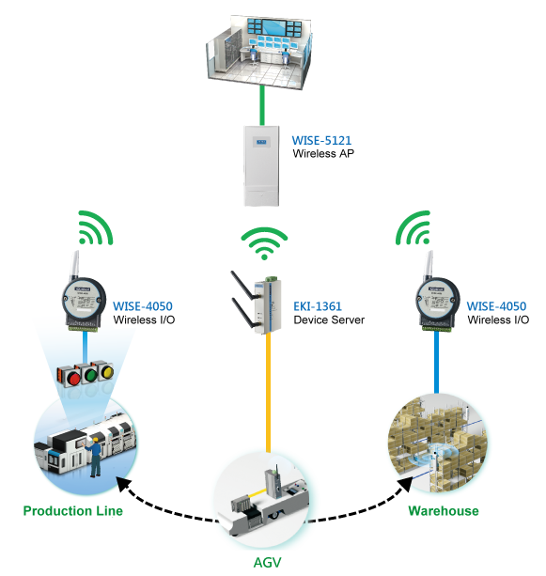
Data Transmission

Slide 20
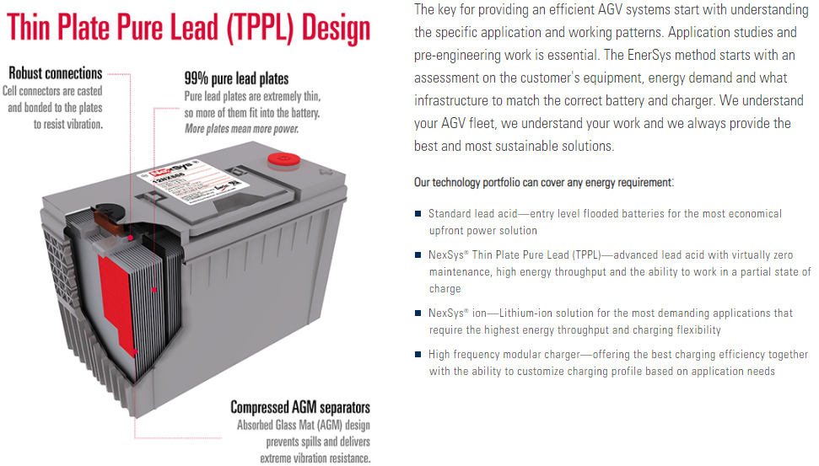
Power Management

